Slide 1

«
Compréhension Illustration UseCase
La nature est comme un immense
livre […] écrit en langue mathématique, et ses caractères sont des triangles, des cercles et des figures géométriques, sans lesquels il serait impossible à tout homme [ou une Intelligence Artificielle] d'en saisir le sens.
Galilée
Il saggiatore,1623
1

Slide 2
Bénéfices
Times Series

Slide 3
Bénéfices
Plan
Intro: What is a time series?
Why are standard ML tools not sufficient?
Concept: Decomposition
Concept: Stationarity
Concept: Autocorrelation
Moving averages
ARMA models
ARIMA models
SARIMAX models
(Optional) Facebook Prophet

Slide 4
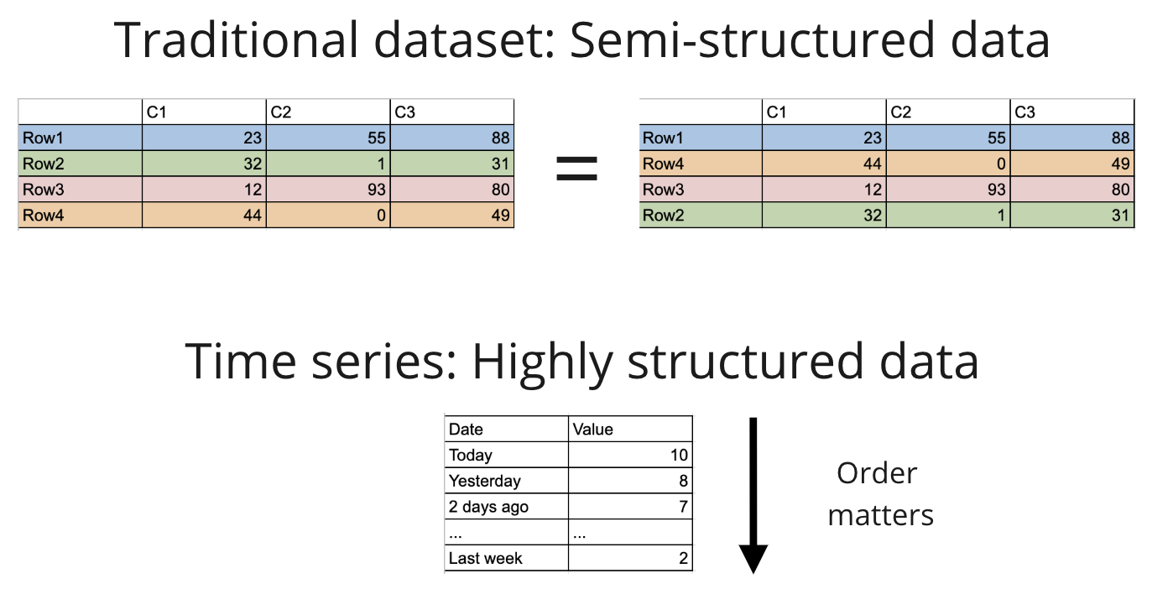
Bénéfices
1. Introduction

Slide 5
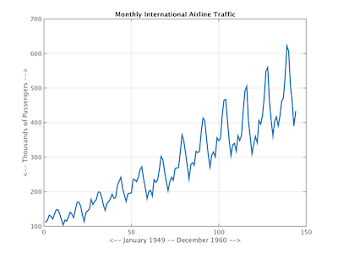
Bénéfices
What a Time Series?
A time series is a series of repeated observations considered within a certain time interval.
The observations are taken at equal (regular/evenly spaced) time intervals.
👉 "Understand" a TS = Decompose, explain the behavior of a time series
👉 "Forecast" = Predict future values based only existing/past observations

Slide 6
Bénéfices
3. Decomposition

Slide 7
Bénéfices
Most time series can be decomposed into several components:
Trend
Seasonal (calendar) / Periodic (non-calendar related)
Irregularities
These components can be additive or multiplicative

Slide 8
Bénéfices
Most time series can be decomposed into several components:
Trend
Seasonal (calendar) / Periodic (non-calendar related)
Irregularities
These components can be additive or multiplicative
How to decompose them?
Manually (for instance using piece-wise OLS regressions)
Use statsmodels.tsa

Slide 9
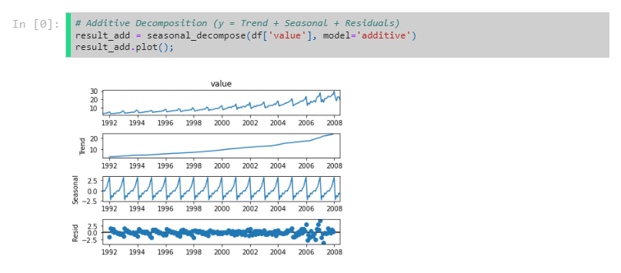
Bénéfices

Slide 10
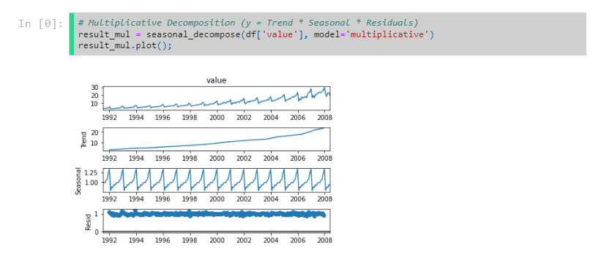
Bénéfices

Slide 11
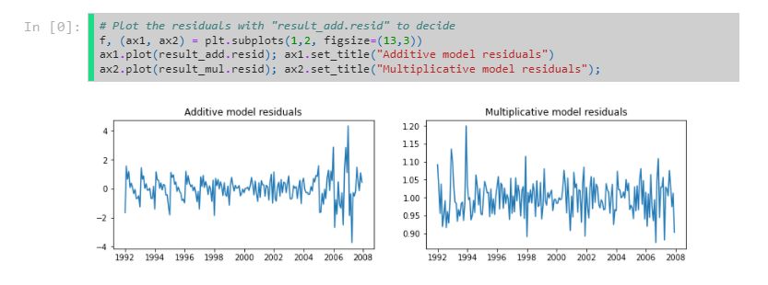
Bénéfices
☝️ Multiplicative residuals seem to have "less notion of time" ➔ better
🤔 Why? Models work best when forecating TS that do not exhibit meaningful statistical changes over time
(so that we can capture these statistical properties and prolongate them in the future)
In time series we call this stationarity.

Slide 12
Bénéfices
☝️ Multiplicative residuals seem to have "less notion of time" ➔ better
🤔 Why? Models work best when forecating TS that do not exhibit meaningful statistical changes over time
(so that we can capture these statistical properties and prolongate them in the future)
In time series we call this stationarity.

Slide 13
Bénéfices
✅ Most statistical forecasting methods are designed to work on stationary time series

Slide 14
Bénéfices
✅ Most statistical forecasting methods are designed to work on stationary time series
1: First, convert a non-stationary series to stationary.
2: Then, forecast stationary TS by prolongating stationary properties
3: Finally reintroduce seasonality, etc...

Slide 15
Bénéfices
4. Stationarity

Slide 16
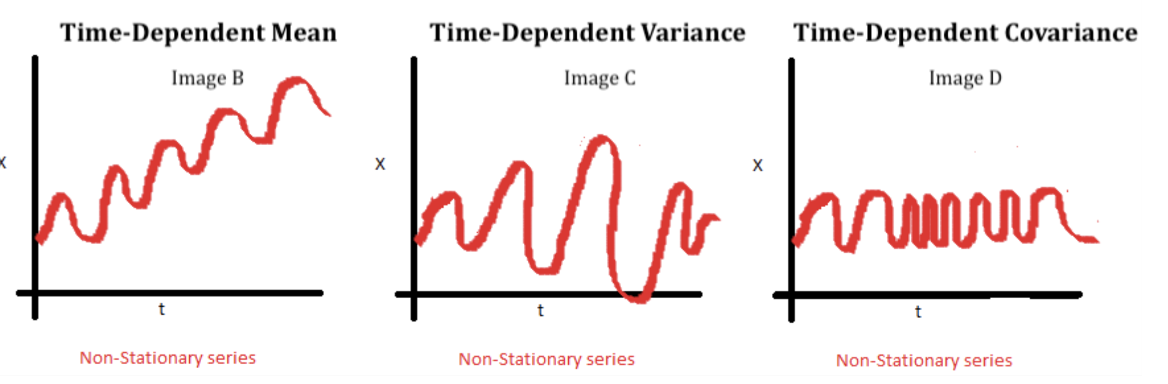
Bénéfices
4. Stationarity
🤔 What is a TS considered as stationary ?
👉 When time does not influence the statistical properties of a time series dataset
mean
variance
autocorrelation (covariance with its lagged terms)

Slide 17
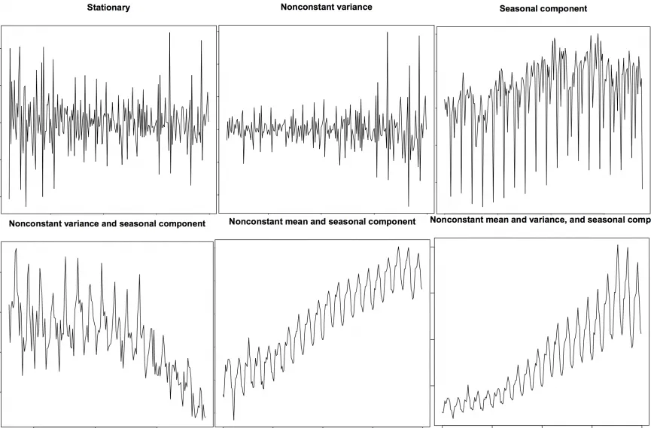
Bénéfices
Examples of stationary and non-stationary series

Slide 18
Bénéfices
Stationary still contains a lot of information!
When analysing stationary data, distribution is affected only by the size of time window, not the location of a time window

Slide 19
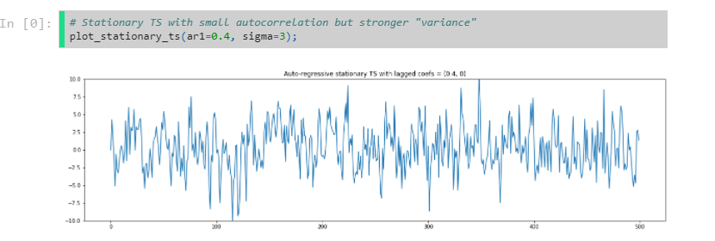
Bénéfices

Slide 20
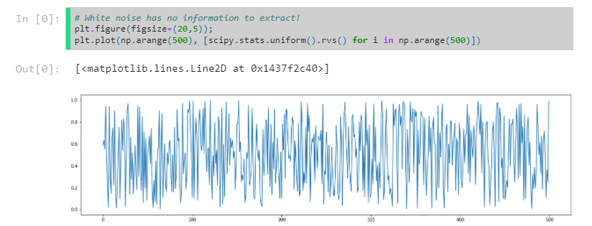
Bénéfices

Slide 21
Bénéfices
How do we test for stationarity?
Visually
Calculate (mean, variance, and autocorrelation) in various intervals
Augmented Dickey Fuller - ADF Test (p-values)

Slide 22
Bénéfices
Augmented Dickey Fuller - ADF Tests

Slide 23
Bénéfices
Augmented Dickey Fuller - ADF Tests

Slide 24
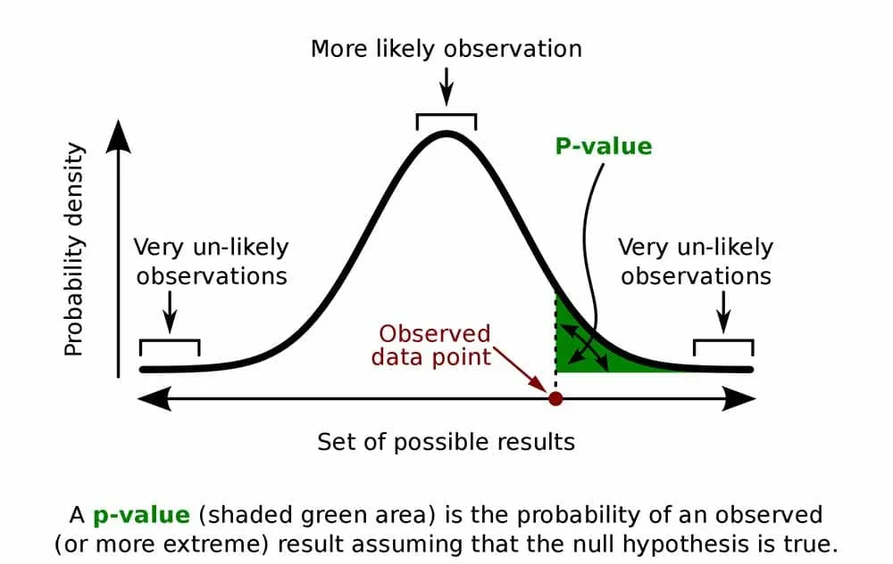
Bénéfices
Augmented Dickey Fuller - ADF Tests
ADF tests the following null hypothesis:
H0: The series is not-stationary.
A p-value close to 0 (e.g. p < 0.05) indicates stationarity.

Slide 25
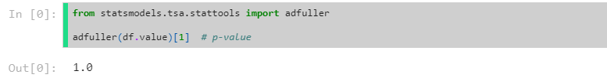
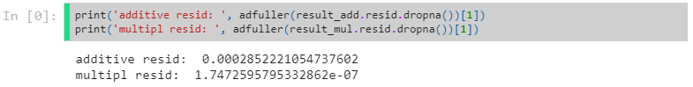
Bénéfices
Augmented Dickey Fuller - ADF Tests
ADF tests the following null hypothesis:
H0: The series is not-stationary.
A p-value close to 0 (e.g. p < 0.05) indicates stationarity.

Slide 26
Bénéfices
Different ways to achieve stationarity
Decomposition e.g. and and predict
Differencing: e.g. and predict
Transformations (log, exp, ... or more advanced variants)
or any combination of these three ways.

Slide 27
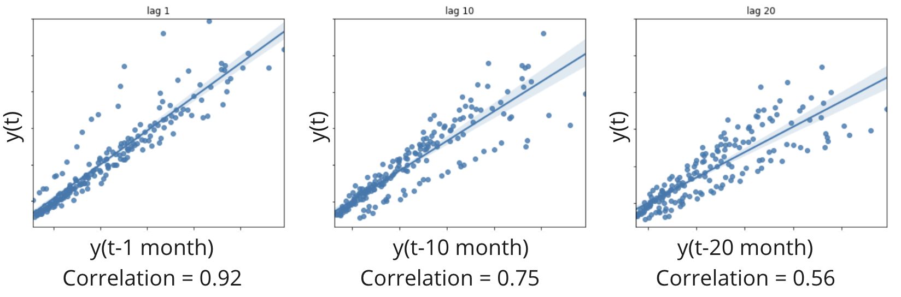
Bénéfices
5. Autocorrelation
Measures the correlation between the time series Y(t) and a lagged version of itself Y(t−i)

Slide 28
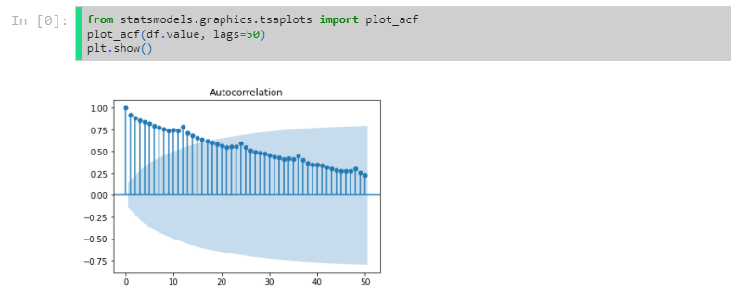
Bénéfices
Plot each correlation in an autocorrelation graph (ACF) below

Slide 29
Bénéfices
Plot each correlation in an autocorrelation graph (ACF) below
The Blue Cone represents a confidence interval (Default 95%)
Peak inside of cone ➔ Not statistically significant

Slide 30
Bénéfices
Plot each correlation in an autocorrelation graph (ACF) below
The Blue Cone represents a confidence interval (Default 95%)
Peak inside of cone ➔ Not statistically significant
🧐 What do the peaks represent?

Slide 31
Bénéfices
Plot each correlation in an autocorrelation graph (ACF) below
The Blue Cone represents a confidence interval (Default 95%)
Peak inside of cone ➔ Not statistically significant
🧐 What do the peaks represent?
Peaks every 12 months indicate the seasonal nature of the data eg. The value in March 1994 will have a relatively strong correlation to the value in March 1993

Slide 32
Bénéfices
Here are a couple of examples of typical ACF plots
Typically we will have a general decline in correlation between a specific time and a day further in the past.
The further back in time you look, the less likely that shift will have an influence

Slide 33
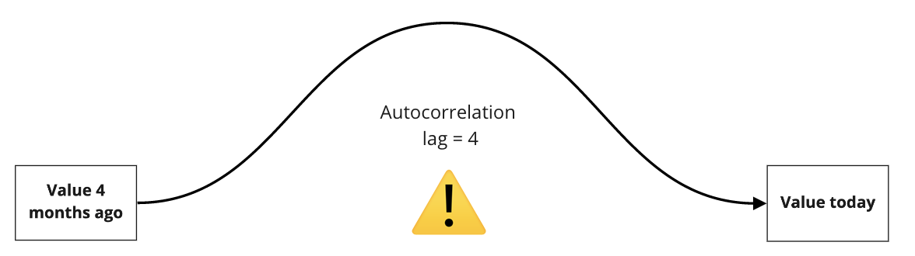
Bénéfices
We've got to be careful, autocorrelation doesn't just measure the direct effect of a lagged time...

Slide 34
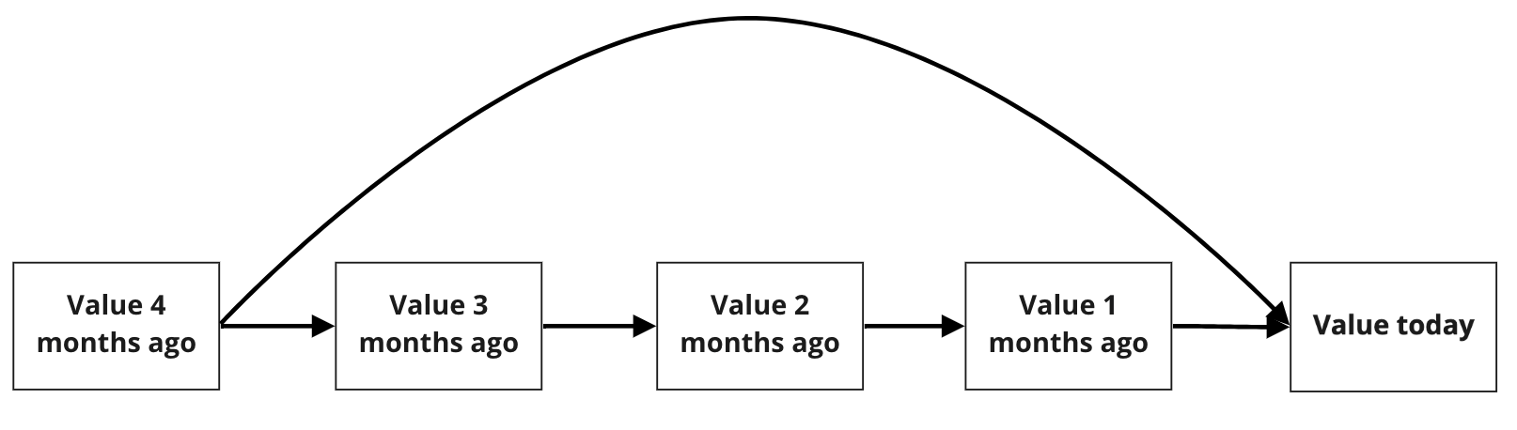
Bénéfices
It measures the indirect effect as well!

Slide 35
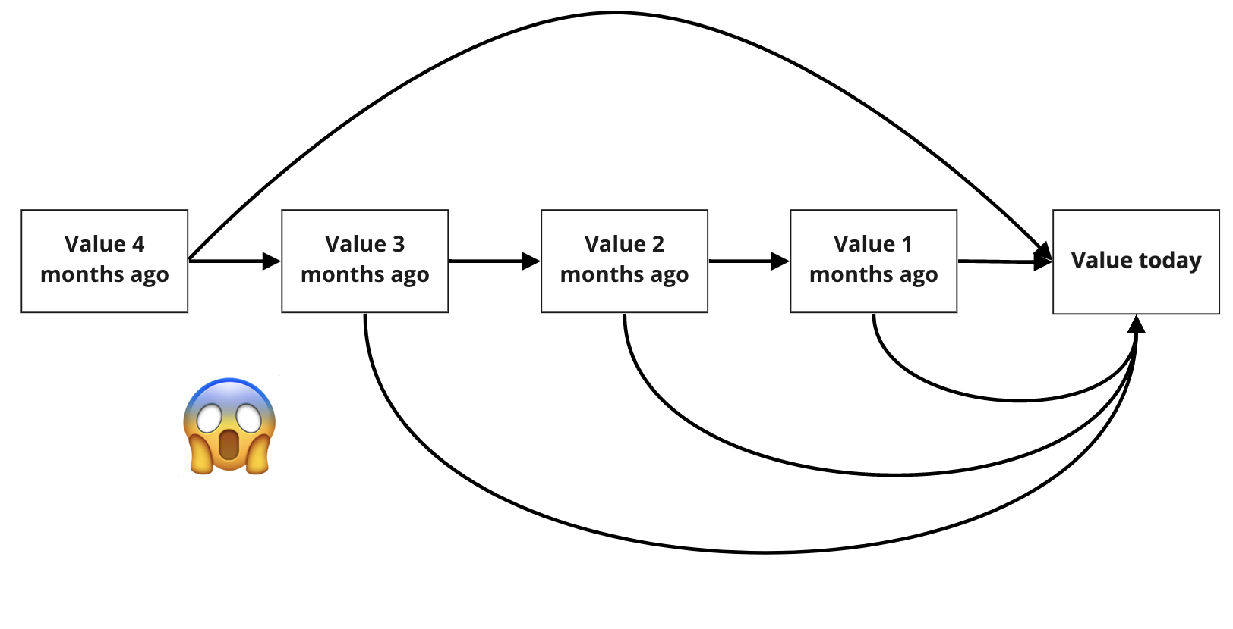
Bénéfices
It can get complicated pretty quickly...
🧐 How could we isolate the influence of a specific time lag?

Slide 36
Bénéfices
We can treat our time series as a linear model
Where p = total number of lags

Slide 37
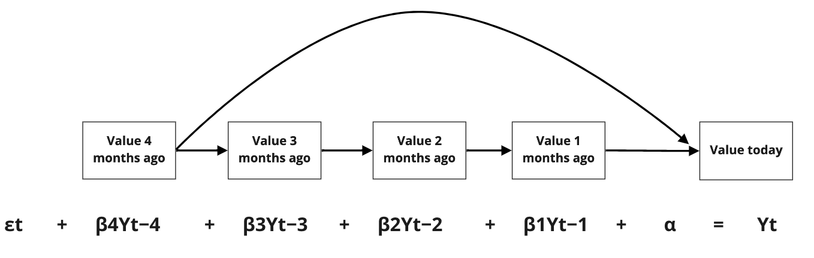
Bénéfices
We can treat our time series as a linear model
Where p = total number of lags

Slide 38
Bénéfices
Analysing the ACF for a specific time lag could be a good predictor for the current value

Slide 39
Bénéfices
Analysing the ACF for a specific time lag could be a good predictor for the current value
But only at face value!
ACF : measures direct & indirect effects

Slide 40
Bénéfices
Analysing the ACF for a specific time lag could be a good predictor for the current value
But only at face value!
ACF : measures direct & indirect effects
This is why we must analyse each lag by isolation as well!

Slide 41
Bénéfices
Analysing the ACF for a specific time lag could be a good predictor for the current value
But only at face value!
ACF : measures direct & indirect effects
This is why we must analyse each lag by isolation as well!
Using our linear modelling, we can isolate each lag term

Slide 42
Bénéfices
Analysing the ACF for a specific time lag could be a good predictor for the current value
But only at face value!
ACF : measures direct & indirect effects
This is why we must analyse each lag by isolation as well!
Using our linear modelling, we can isolate each lag term
This is known as Auto Regression (AR) and the analysis of lag terms is known as a Partial Autocorrelation Function (PACF)

Slide 43
Bénéfices
We can compute the partial correlation coefficients βiof the multivariate regression
Then plot each βi in a PACF graph

Slide 44
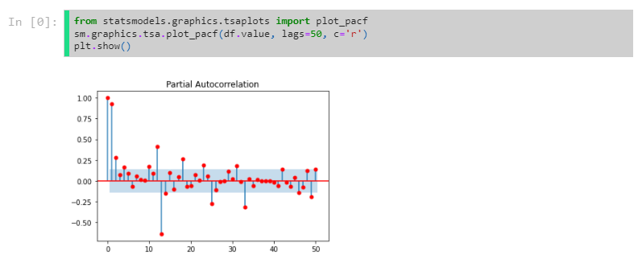
Bénéfices
We can compute the partial correlation coefficients βiof the multivariate regression
Then plot each βi in a PACF graph

Slide 45
Bénéfices
We can compute the partial correlation coefficients βiof the multivariate regression
Then plot each βi in a PACF graph
Typically, we will have a much sharper decline with PACF lag values in comparison with ACF

Slide 46
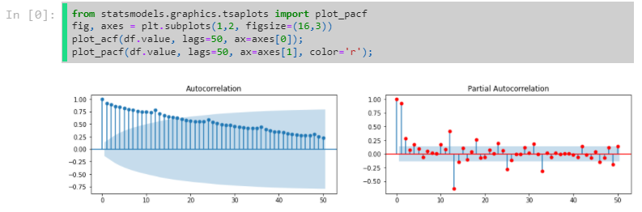
Bénéfices

Slide 47
Bénéfices
ACF is simply the correlation of the series with itself
Slow exponential decrease
if X(t) is always correlated with X(t−1), then it also correlated with X(t−2)
PACF is even more informative
It removes intermediary correlations

Slide 48
Bénéfices
ACF is simply the correlation of the series with itself
Slow exponential decrease
if X(t) is always correlated with X(t−1), then it also correlated with X(t−2)
PACF is even more informative
It removes intermediary correlations
👉 Annual seasonality is confirmed (peaks at lag = 12)

Slide 49
Bénéfices
6. Moving Averages

Slide 50
Bénéfices
6. Moving Averages
Predicting the next value based on the average value from a specific window size

Slide 51
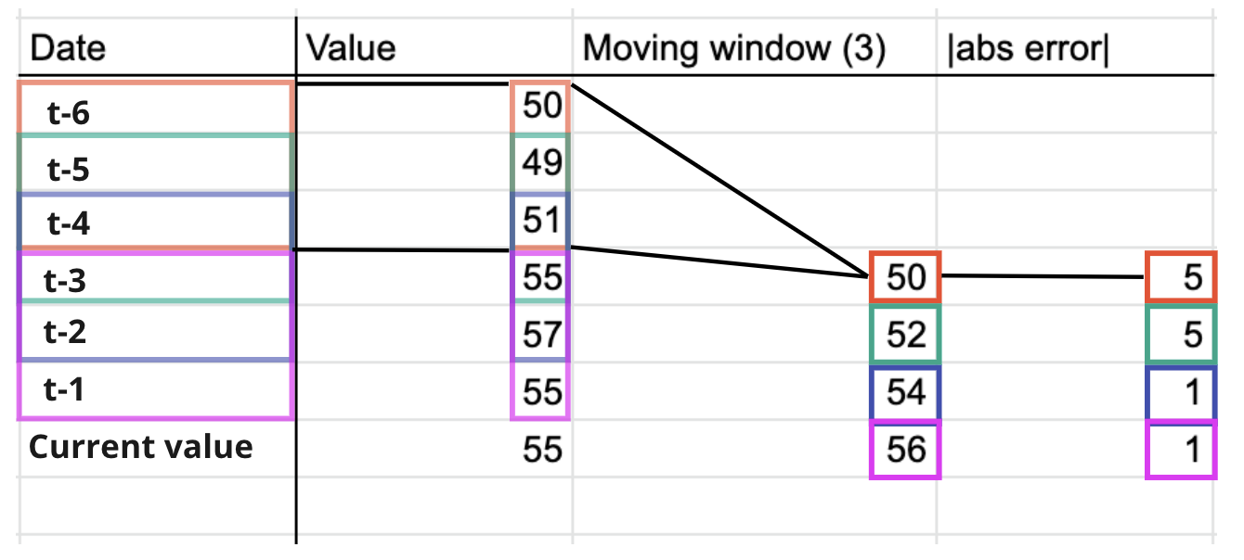
Bénéfices
6. Moving Averages
Predicting the next value based on the average value from a specific window size

Slide 52
Bénéfices
Similar to the Auto Regressive model with PACF, we will linearly model the errors between our moving average predictions and the actual values

Slide 53
Bénéfices
Similar to the Auto Regressive model with PACF, we will linearly model the errors between our moving average predictions and the actual values
Where q = total number of lags in the past

Slide 54
Bénéfices
7. Auto Regressive Moving Average ( ARMA )
Let's combine our two models Auto Regressive (AR) & Moving Average model into a single model

Slide 55
Bénéfices
7. Auto Regressive Moving Average ( ARMA )
Let's combine our two models Auto Regressive (AR) & Moving Average model into a single model
ARMA(p,q)
As a linear combination p lags of Y
plus a linear combination of q lagged forecast errors

Slide 56
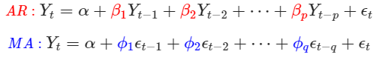
Bénéfices
7. Auto Regressive Moving Average ( ARMA )
Let's combine our two models Auto Regressive (AR) & Moving Average model into a single model
ARMA(p,q)
As a linear combination p lags of Y
plus a linear combination of q lagged forecast errors

Slide 57
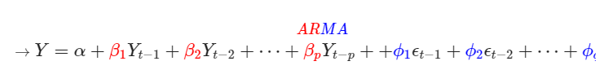
Bénéfices
7. Auto Regressive Moving Average ( ARMA )
Let's combine our two models Auto Regressive (AR) & Moving Average model into a single model
ARMA(p,q)
As a linear combination p lags of Y
plus a linear combination of q lagged forecast errors

Slide 58
Bénéfices
Hyperparameters p & q
p relates to how many lags we want to incorpriate into AR
q relates to how many lags we want to incorpriate into MA

Slide 59
Bénéfices
Hyperparameters p & q
p relates to how many lags we want to incorpriate into AR
q relates to how many lags we want to incorpriate into MA
🧐 How do we know how many lags to use?

Slide 60
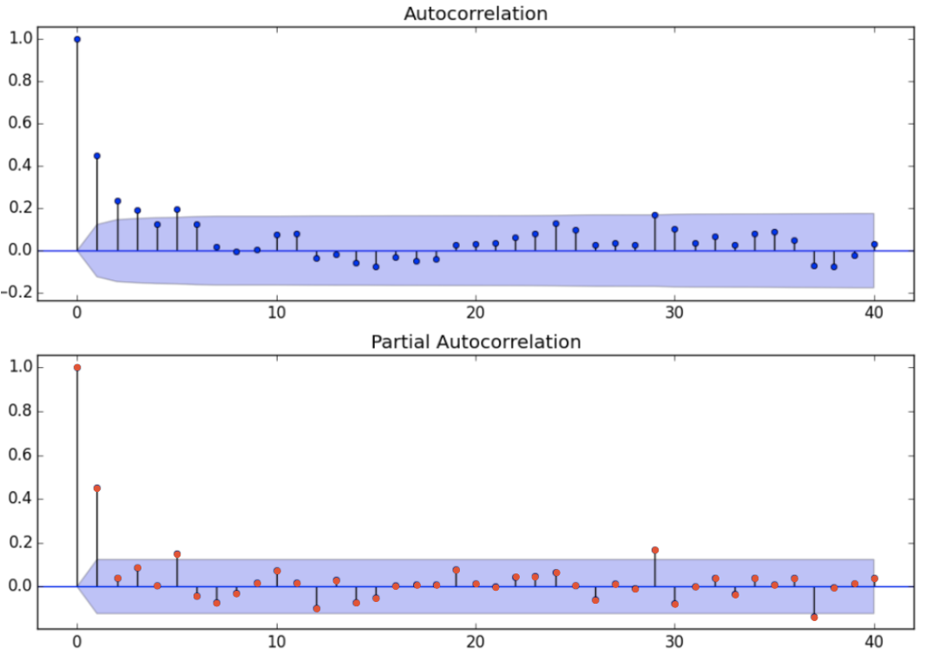
Bénéfices
Count the number of lags before the values drop below the confidence levels

Slide 61
Bénéfices
Count the number of lags before the values drop below the confidence levels
We use the PACF plot to calculate the value for p = 2 or 1
We use the ACF plot to calculate the value for q = 4 or 3

Slide 62
Bénéfices
Count the number of lags before the values drop below the confidence levels
We use the PACF plot to calculate the value for p = 2 or 1
We use the ACF plot to calculate the value for q = 4 or 3
ARMA(2,4) or ARMA(1,3)

Slide 63
Bénéfices
8. Auto Regressive Integrated Moving Average ( ARIMA )

Slide 64
Bénéfices
7. Auto Regressive Integrated Moving Average ( ARIMA )
One of the main assumptions for time series modelling is that the data must be stationary

Slide 65
Bénéfices
7. Auto Regressive Integrated Moving Average ( ARIMA )
One of the main assumptions for time series modelling is that the data must be stationary
We can apply differencing to our dataset to turn non-stationary data into stationary data 🎉

Slide 66
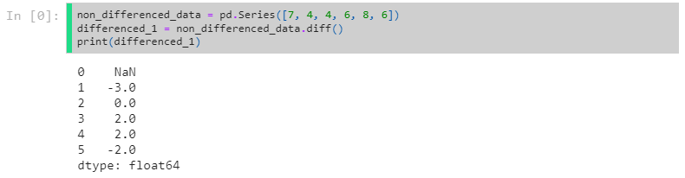
Bénéfices
we will plot the difference between each lag rather than the actual value for each lag

Slide 67
Bénéfices
we will plot the difference between each lag rather than the actual value for each lag
We should keep differencing until our data gets stationary

Slide 68
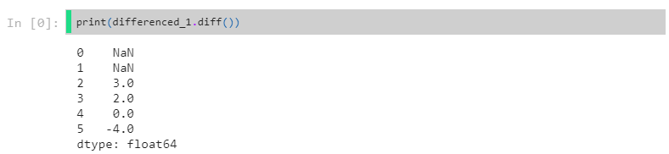
Bénéfices
we will plot the difference between each lag rather than the actual value for each lag
We should keep differencing until our data gets stationary

Slide 69
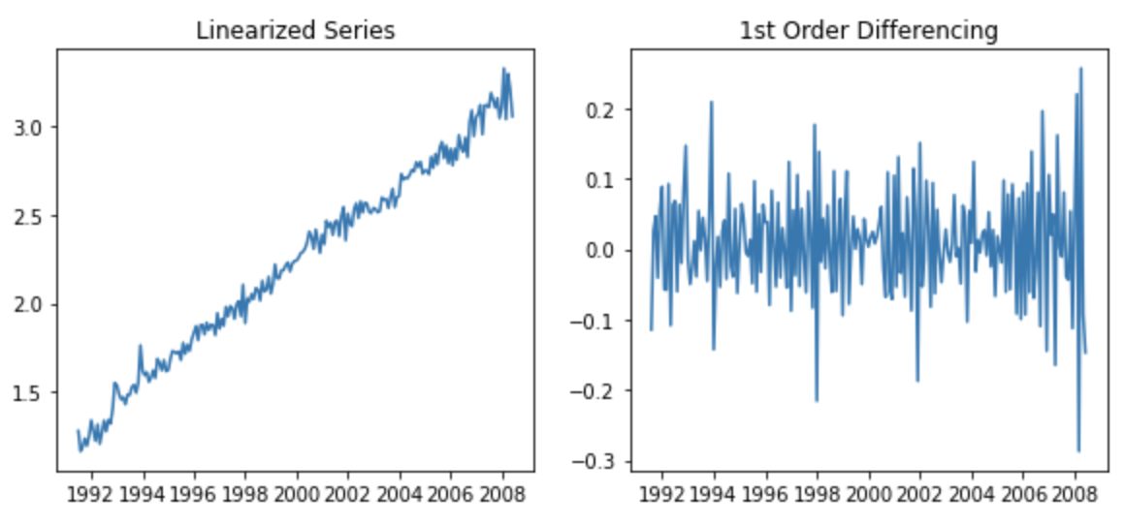
Bénéfices
For instance, here is a non-stationary data that we smoothed out using differencing (removed the function of time in our series) 💪

Slide 70
Bénéfices

Slide 71
Bénéfices
Auto Regressive Integrated Moving Average.
I: Uses differencing to achieve stationarity. (i.e Try to predict Ydiff)
AR: Linear combination between Y and lagged terms Yt−i
MA: Linear combination between Y and residual errors from the AR model above

Slide 72
Bénéfices
AR-I-MA intuition ?
AR process is simply a linear combination of p lags
A process whose values are a direct linear combination of its past values
a one time "shock" will propagate far into the future
ex: GDP may have β1 close to 1, because next year's GDP can be stable year-on-year for a given country
If a country suddenly experiences a great boom (eg. +7% in 2020) due to new policies...
... this advance in absolute GDP may propagate far in the future
Not necessarily stationnary

Slide 73
Bénéfices
MA process is a linear combination of q residuals
A process whose values are a direct linear combination of its past changes
Any "shock" will have a limited time effect.
ex: GDP: a conjonctural shock (e.g. pandemic) decrease it by 10% a given year
It may "bounce back" rapidly to normal after 2 years
ϕ1,ϕ2ϕ1,ϕ2 non-null
Always stationary

Slide 74
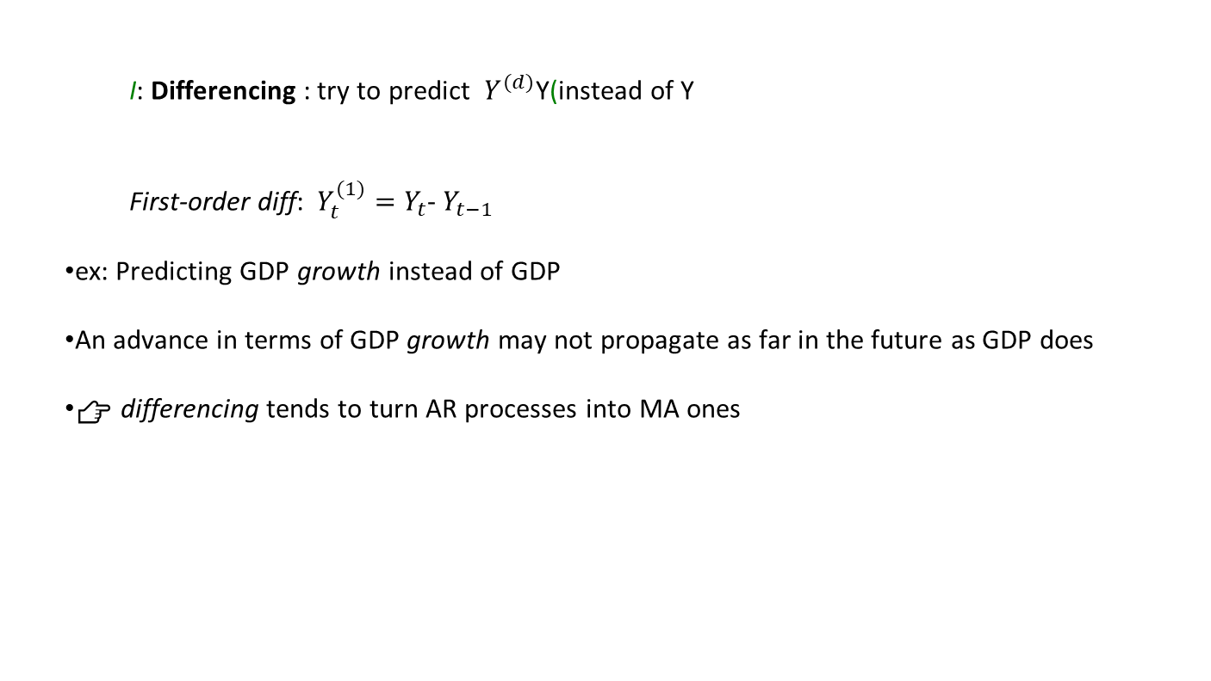
Bénéfices
I: Differencing : try to predict $Y^{(d)}$Y(instead of Y
First-order diff: $Y_{t}^{(1)}=Y_{t}$- $Y_{t−1}$
ex: Predicting GDP growth instead of GDP
An advance in terms of GDP growth may not propagate as far in the future as GDP does
👉 differencing tends to turn AR processes into MA ones

Slide 75
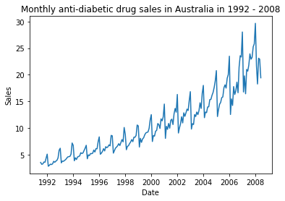
Bénéfices
Let's get back to our initial dataset and model it via ARIMA
🤔 Can we stationarize it via differencing ?

Slide 76
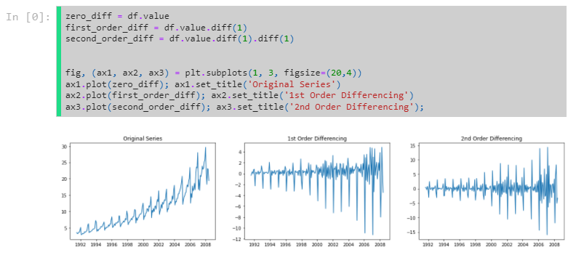
Bénéfices

Slide 77
Bénéfices
❌ Not stationary : Seasonality is still obviously present
❌ Cannot apply ARIMA directly (we will see SARIMA later) Need to deseasonalize

Slide 78
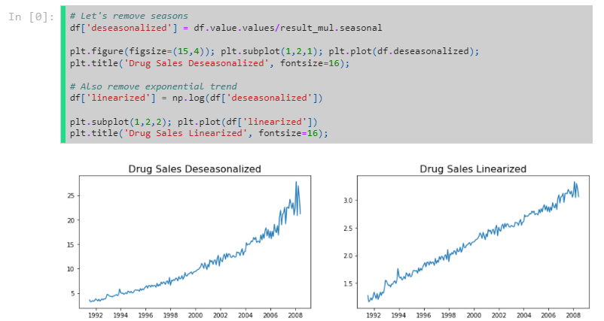
Bénéfices

Slide 79
Bénéfices
Let's re-run our differencing analysis on this new linearized time series

Slide 80
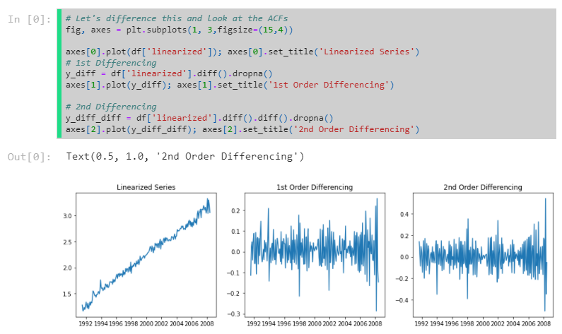
Bénéfices

Slide 81
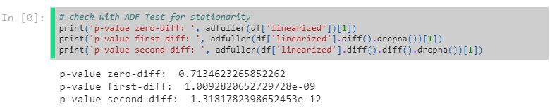
Bénéfices

Slide 82
Bénéfices
No need to over-differentiate
☝️ We should select d=1
Usually, 1-diff is enough! If not, you might have exponential behavior and might want to use a log transformation instead! Alternatively, we can de-trend and work with the detrended series without differencing.

Slide 83
Bénéfices
Another way to determine how many orders of differencing to apply

Slide 84
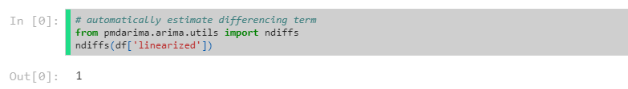
Bénéfices
Another way to determine how many orders of differencing to apply

Slide 85
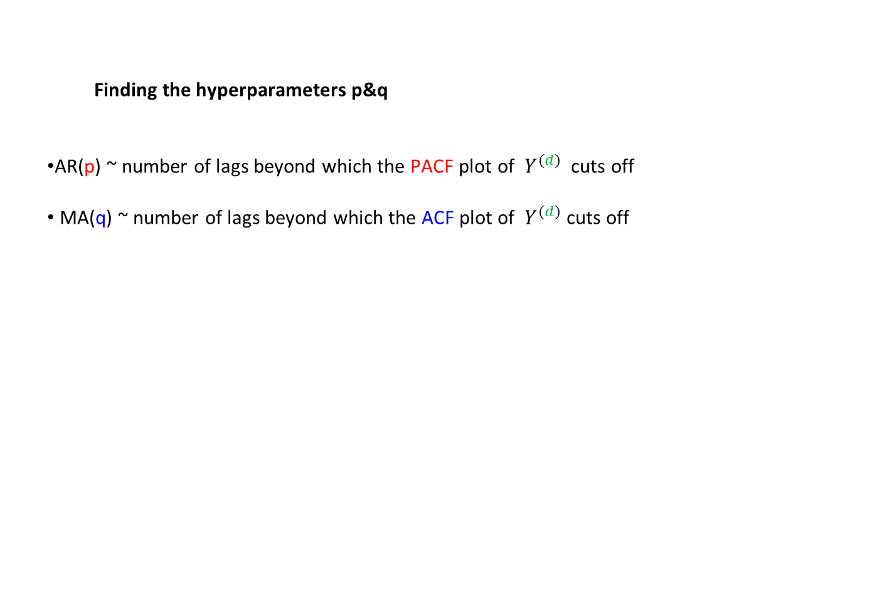
Bénéfices
Finding the hyperparameters p&q
AR(p) ~ number of lags beyond which the PACF plot of $Y^{(d)}$ cuts off
MA(q) ~ number of lags beyond which the ACF plot of $Y^{(d)}$cuts off

Slide 86
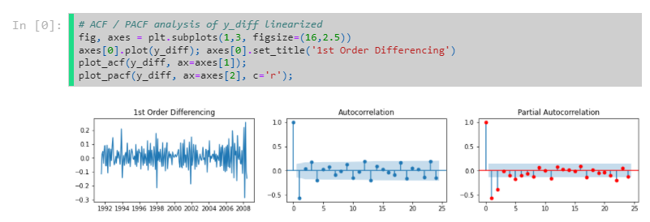
Bénéfices
Finding the hyperparameters p&q
AR(p) ~ number of lags beyond which the PACF plot of $Y^{(d)}$ cuts off
MA(q) ~ number of lags beyond which the ACF plot of $Y^{(d)}$cuts off

Slide 87
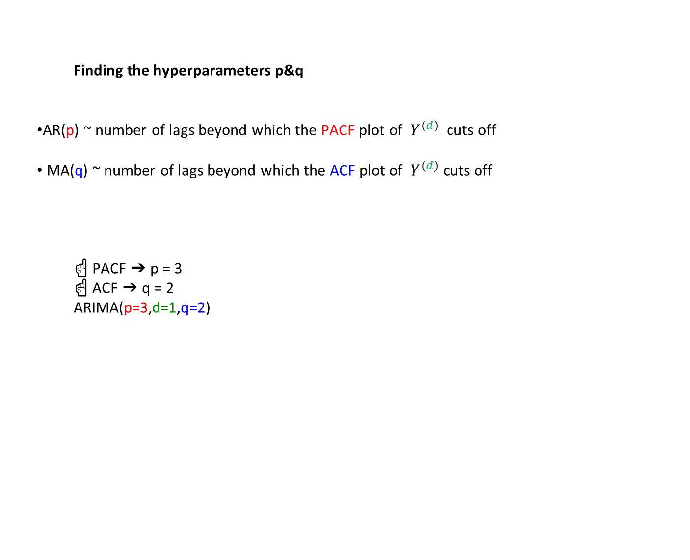
Bénéfices
Finding the hyperparameters p&q
AR(p) ~ number of lags beyond which the PACF plot of $Y^{(d)}$ cuts off
MA(q) ~ number of lags beyond which the ACF plot of $Y^{(d)}$cuts off
☝️ PACF ➔ p = 3 ☝️ ACF ➔ q = 2
ARIMA(p=3,d=1,q=2)

Slide 88
Bénéfices
☝️ More nuanced rules can be applied to hyper parameter tuning
Use the Box-Jenkins method
IMPORTANT: more than one model might explain your data.
📚 More details can be found here and here
When in doubt, choose the simpler model!

Slide 89
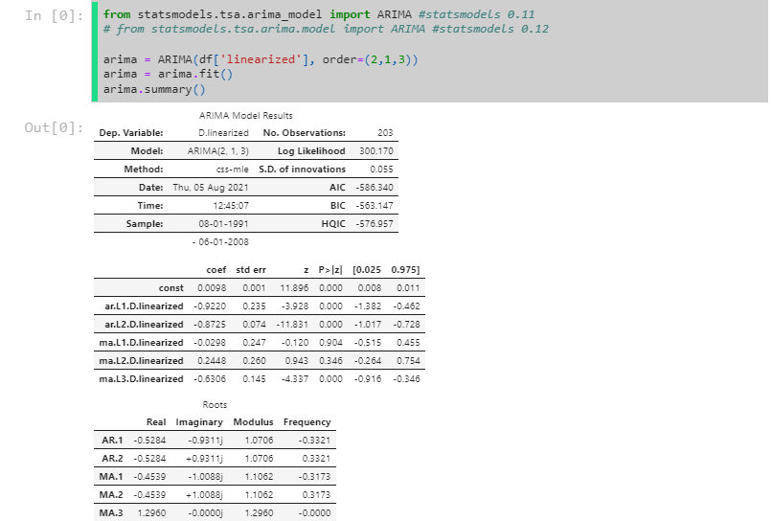
Bénéfices

Slide 90
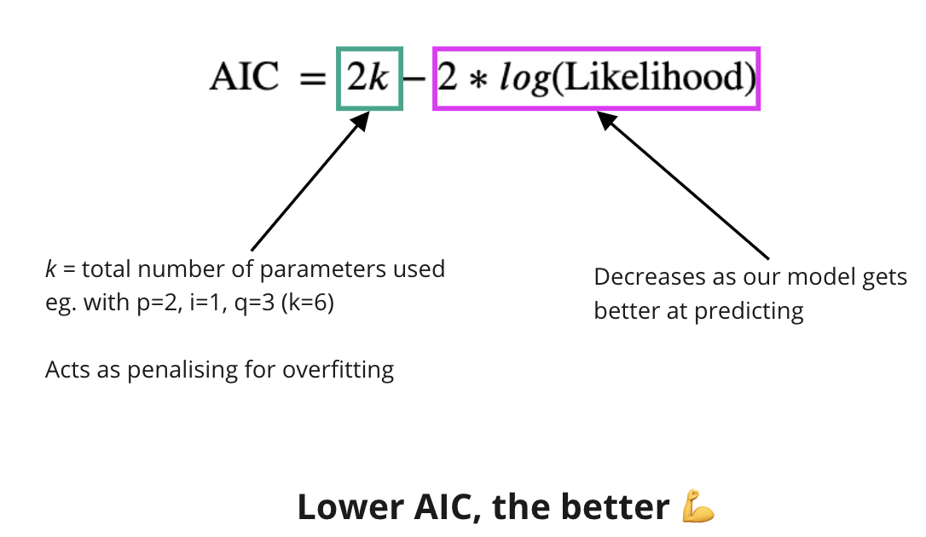
Bénéfices
Performance metrics- Akaike Information Criterion

Slide 91
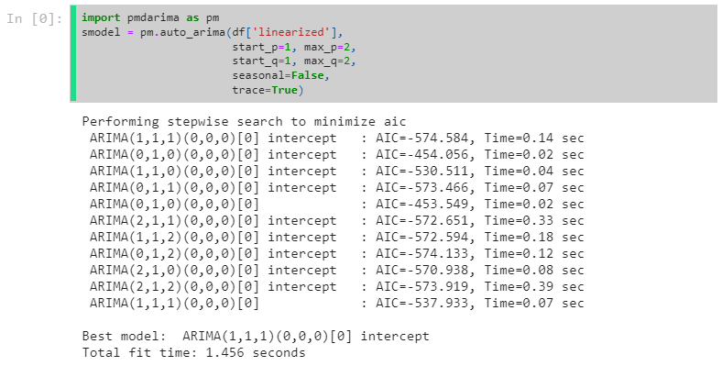
Bénéfices
We can also use auto_arima to GridSearch the hyper-parameters p, d, q 🥳

Slide 92
Bénéfices
⚠️ Several models have similar AIC values around -570.
Any of them might be the "true" underlying process
👉 When in doubt, pick the simplest model.
ARIMA(p=0,d=1,q=1)

Slide 93
Bénéfices
Evaluate performance

Slide 94
Bénéfices
.plot_predict() to glance at our predictions

Slide 95
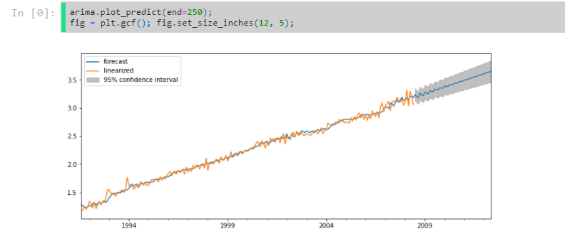
Bénéfices
.plot_predict() to glance at our predictions

Slide 96
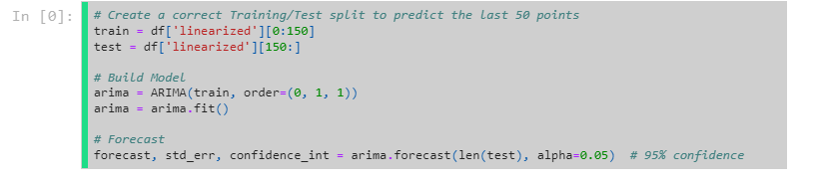
Bénéfices
Use .forecast to properly access forecasts and uncertainty intervals

Slide 97
Bénéfices
Use .forecast to properly access forecasts and uncertainty intervals

Slide 98
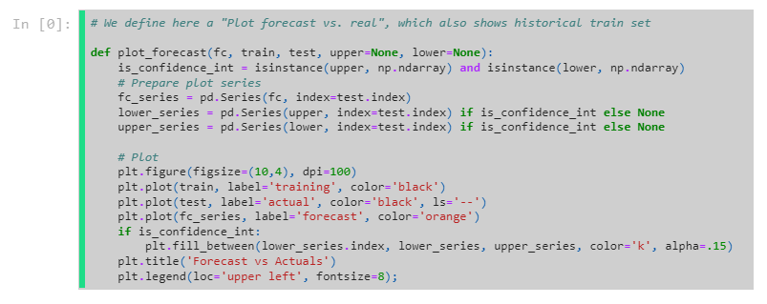
Bénéfices

Slide 99
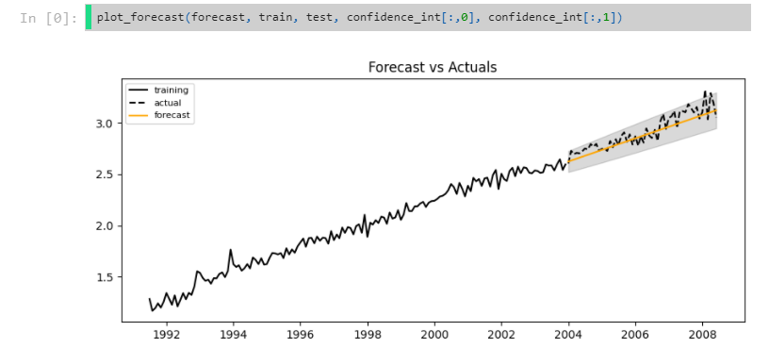
Bénéfices

Slide 100
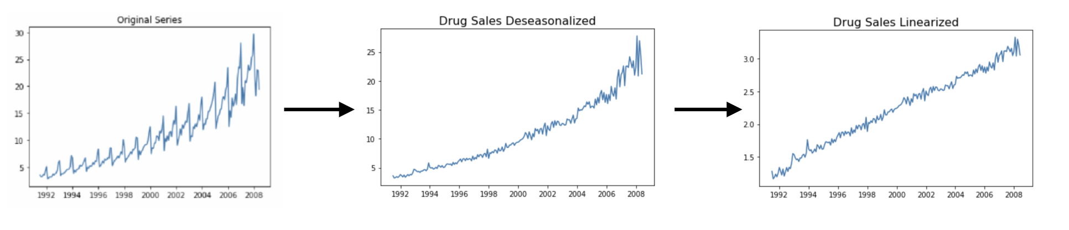
Bénéfices
⚠️Remember, this wasn't our original time series!
This is the linearized version, we extracted the seasonal and exponential components.

Slide 101
Bénéfices
⚠️Remember, this wasn't our original time series!
This is the linearized version, we extracted the seasonal and exponential components.
Let's add them back in

Slide 102
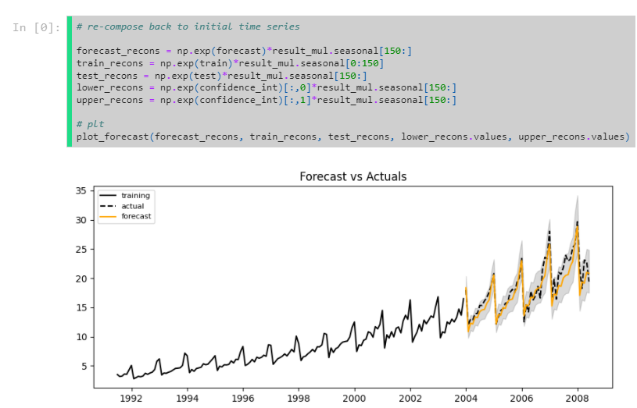
Bénéfices

Slide 103
Bénéfices
Check residuals for inference validity

Slide 104
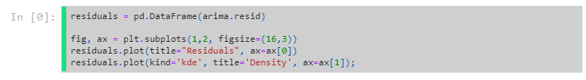
Bénéfices
Check residuals for inference validity

Slide 105
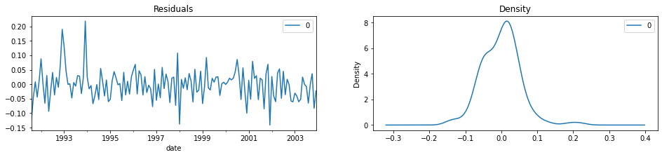
Bénéfices
Check residuals for inference validity

Slide 106
Bénéfices
✅ Residals of equal variance over time (not homoscedastic)
✅ Approximati normally distributed
👉 We can trust our "confidence interval"

Slide 107
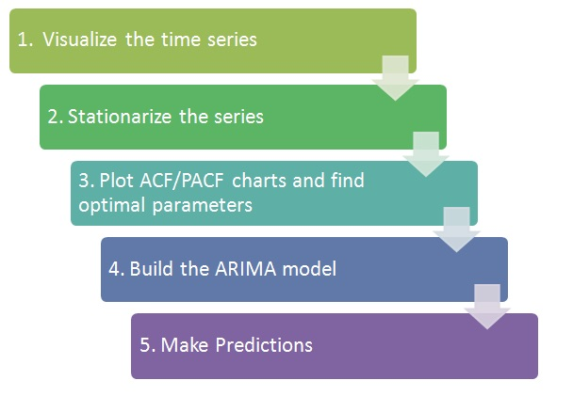
Bénéfices
Box Jenkins Method (Summary)

Slide 108
Bénéfices
Box Jenkins Method (Details)
Apply transformations to make time series stationary (detrending, transformations, differencing).
If differencing, keep track of order d of differencing. Don't overdifference!
Confirm stationarity (visually, ACF, ADF test)
Plot ACF/PACF, identify likely AR and MA orders p, q.
Fit original (non-differenced) data with ARIMA model of order p, d, q
Try a few other values around these orders
Of all models with similarly low AIC, pick the least complex one
Inspect residuals: If ACF and PACF show white noise (no signal left)➔ You are done.
Otherwise ➔ Iterate (Try other transformations, change order of differencing,
Add/Remove MA/AR terms)
(Optional) Compare with Auto-ARIMA output trace
Take a look at the Rules and this

Slide 109
Bénéfices
9. Seasonal ( SARIMA )

Slide 110
Bénéfices
9. Seasonal ( SARIMA )
Removes the need to deseasonalize our data

Slide 111
Bénéfices
9. Seasonal ( SARIMA )
Removes the need to deseasonalize our data

Slide 112
Bénéfices
9. Seasonal ( SARIMA )
Removes the need to deseasonalize our data
Let's plot again our original Time Series:

Slide 113
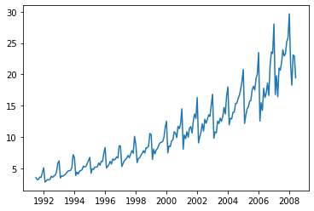
Bénéfices

Slide 114
Bénéfices
Where are the season windows in our data?

Slide 115

Bénéfices
We've identified a repeating pattern within our data.
The window looks like a window size of 12

Slide 116
Bénéfices
We've identified a repeating pattern within our data.
The window looks like a window size of 12
This makes sense! Yearly patterns are very common
❌ Not great for stationarity

Slide 117
Bénéfices
We're going to take seasonal patterns into account by modelling at the individual lag level and at the seasonal level

Slide 118

Bénéfices
Let's use our differencing as an example of modelling at different time windows.
We'll do our: $Y_{diff}^{}=Y_{t}$- $Y_{t−k}$
Normal differencing $Y_{diff}^{}=Y_{t}$- $Y_{t−k}$ ⬅ individual lag
Seasonal differencing $Y_{sdiff}^{}=Y_{t}$- $Y_{t−m}$(m=12) ⬅ 12 month lag

Slide 119


Bénéfices

Slide 120
Bénéfices
Just like we applied differencing at two different lag levels, we can apply the other hyperparmeters (p and q) as well!
SARIMA has 7 hyperparameters
p ~ AR hyperparameter for individual lag level
d ~ Integration hyperparameter for individual lag level
q ~ MA hyperparameter for individual lag level
P ~ AR hyperparameter for seasonal lag level
D ~ Integration hyperparameter for seasonal lag level
Q ~ MA hyperparameter for seasonal lag level
👉 GridSearch advised 👉 Must only choose S manually (S = 12, for annual seasonality)
📚blog post on hyperparams

Slide 121


Bénéfices

Slide 122

Bénéfices

Slide 123

Bénéfices

Slide 124


Bénéfices

Slide 125

Bénéfices

Slide 126
Bénéfices
SARIMA(X) for eXogenous features
We can take advantage of two correlated times series by using one to predict another

Slide 127
Bénéfices
SARIMA(X) for eXogenous features
We can take advantage of two correlated times series by using one to predict another
Suppose you were trying to predict the price of electricity in for the next 48 hours
Hypothesis
Lower temperatures = higher electricity demand for heating = higher electricity prices
Therefore
Using past variations of:
market prices (endogenous variable) ⬅ Itself
external weather forecasts (exogenous variable) ⬅ External time series
we can then predict the price of electricity 💪

Slide 128

Bénéfices
SARIMA(X) for eXogenous features
⚠️ you need to have access to the forecasted values of exog variable for such model to help you

Slide 129

Bénéfices

Slide 130

Bénéfices

Slide 131

Bénéfices

Slide 132

Bénéfices

Slide 133

Bénéfices

Slide 134
Bénéfices
Other types of time series models:
Exponential smoothing (ETS): Moving average with exponentially decaying memory of past values. Great for non-linear trends with changing mean over time
Holt's trend corrected exponential smoothing: Series has linear trend with slope that changes over time
Holt-Winter's method: Adds seasonality
See more

Slide 135
Bénéfices
Bibliography
Time Series Analysis Blog (1/2 : concepts)
Time Series Analysis Blog (2/2 : arima models)

Slide 136
Bénéfices
☝️ best model found

Slide 137


Bénéfices
Let's remember Linear Regression:
$Y= β_{0}$+ $β_{1}X_{1}+ ∈$
❓What about non-linear behavior as below?

Slide 138

Bénéfices
Let's remember Linear Regression:
$Y= β_{0}$+ $β_{1}X_{1}+ ∈$
❓What about non-linear behavior as below?
👉 If we add a new transformed feature $X_{1}^{2}$we have a better fit (in red)
$Y= β_{0}$+ $β_{1}X_{1}+β_{2}X_{1}^{2}$ $+…+ ∈$

Slide 139

Bénéfices
🤔 We could engineer very complex features: $X_{1}^{3} , X_{1}^{6}$ ,($X_{1}^{2}$* $X_{2}^{5}$),...

Slide 140

Bénéfices
🤔 We could engineer very complex features: $X_{1}^{3} , X_{1}^{6}$ ,($X_{1}^{2}$* $X_{2}^{5}$),...
Our $R^{2}$ will keep increasing with every additional feature!

Slide 141

Bénéfices
🤔 We could engineer very complex features: $X_{1}^{3} , X_{1}^{6}$ ,($X_{1}^{2}$* $X_{2}^{5}$),...
Our $R^{2}$ will keep increasing with every additional feature!
We just solved Data Science!

Slide 142


Bénéfices
🤔 We could engineer very complex features: $X_{1}^{3} , X_{1}^{6}$ ,($X_{1}^{2}$* $X_{2}^{5}$),...
Our $R^{2}$ will keep increasing with every additional feature!
We just solved Data Science!

Slide 143

Bénéfices
Overfitting and Underfitting
What's bad about the first model? About the third ?

Slide 144
Bénéfices
Overfitting and Underfitting
What's bad about the first model? About the third ?
The first does not capture all the information in the data (high bias model).
The third finds signal that isn't there (noise). It will not generalize well to new data points. (high variance model: It will vary a lot from dataset to dataset)

Slide 145

Bénéfices

Slide 146


Bénéfices
The Bias-Variance Tradeoff
One of the most important concepts in Data science!
📚 Great read TotalError=${Biais}^{2}$ +Variance+IrreducibleError

Slide 147
Bénéfices
❓How do we find the optimal model complexity?

Slide 148

Bénéfices
The one that minimizes the Test Error on a unseen dataset

Slide 149

Bénéfices
🤔 Don't have time to try many models?
Use learning curves to at least diagnose the only one you have!

Slide 150

Bénéfices
❗️Data Leak❗️ Diagnose your model using a Validation Set instead!

Slide 151
Bénéfices
❗️Data Leak❗️ Diagnose your model using a Validation Set instead!
👉 Cross-validate instead of a using single holdout val set to generalize better!

Slide 152
Bénéfices
Solutions for Overfitting
Simplify your model relatively to your data
Get more observations
Feature selection (manual or automated)
Dimensionality reduction (Unsupervised Learning)
Early stopping (Deep Learning)
Regularization of your Loss function

Slide 153
Bénéfices
3. Model Tuning
❓ How to choose best hyper-parameters (e.g: alpha ...)

Slide 154

Bénéfices
The grid search method
Explores different hyperparam value combinations to find those optimizing performance
Hold-out a validation set (never use test set for model tuning!)
Select which grid of values of hyper-parameters to try out
For each combinations of values, measure your performance on the validation set
Select hyperparams that produce the best performance

Slide 155
Bénéfices
💻 Let's fine-tune an Linear model with ElasticNet regularization

Slide 156

Bénéfices
💻 Let's fine-tune an Linear model with ElasticNet regularization

Slide 157

Bénéfices
💻 Let's fine-tune an Linear model with ElasticNet regularization

Slide 158

Bénéfices

Slide 159

Bénéfices
🔥 Grid Search CV
Randomy split your training set into k folds of same size
Make fold #1 a val_set, train model on other k-1 folds & mesure val_score
Make fold #2 a val_set and repeat
...
Compute average val_score over all folds

Slide 160
Bénéfices
☝️This is your cross-validated score for one given set of hyper-parameters
Repeat for each value of hyper-param to test
Separe test set for final evaluation only (once hyper-params are chosen)

Slide 161

Bénéfices
Welcome to Sklearn GridSearchCV 🚀

Slide 162

Bénéfices

Slide 163
Bénéfices
👎 Limitations of Grid Search:
Computationally costly
The optimal hyperparameter value can be missed
Can overfit hyperparameters to the training set if too many combinations are tried out for too small a dataset

Slide 164

Bénéfices
Random Search
Randomly explore hyperparameter values from:
A hyperparameter space to randomly sample from
The specified number of samples to be tested

Slide 165

Bénéfices
Sklearn's RandomizedSearchCV

Slide 166

Bénéfices
Choose hyperparameter probability distribution wisely
Can be generated with scipy.stats.distributions

Slide 167


Bénéfices
loguniform great for coarse-grain search across sever orders of magnitude
e.g. loguniform(0.01, 1) search over [10−2, 10−1, 1]
Doc

Slide 168
Bénéfices
RandomizedSearch vs GridSearch

Slide 169

Bénéfices
👉 Randomized Search:
Less typing, if you want to try many values
Control for the number of combinations to try / search time
Usefull when some hyperparams are more important than others
In any case: ✅ Always start with a coarse grain approach (can use Grid or RandomSearch) ✅ Then only, fine-tune your search

Slide 170
Bénéfices
🔥 Key Summary 🔥
👉 FIT = finding best PARAMS so as to minimize LOSS
👉 FINETUNE = finding best HYPERPARAMS so as to maximize PERF METRIC

